Slide 1
Show Us Your Craft
Prework
Walk through the technology project that you are most proud of in your career. Be prepared for a 30 minute in-depth dive of the work that you did.
Some ideas of things to include in your presentation:
What problem were you solving?
What work did you specifically do?
What were some the critical decisions (technical and others) made? What information did you have at the time of decision? Why did you made the decisions you did?
What were some of your biggest learnings?
What would you do differently (if anything) if you did all over again?
Deep dive on technology architecture. (be prepared to show us code, if possible)
What were some of the important dependencies? How did you deal with those?
How did you balance the short vs long term debate?
What did you do to ensure that your solution can stand the test of time and new developers joining the project?
Anything else we should know?

Slide 2
“Show Us Your Craft” Vignesh Palaniappan
Notes:
Introduction

Slide 3
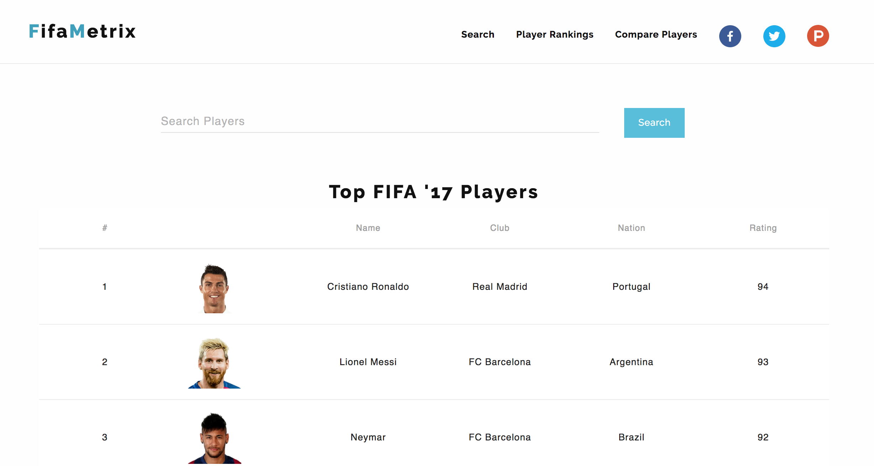
Notes:
FifaMetrix is a platform that:
- Analyzes players across FIFA versions
- Ranks players based off FIFA statistics
- Compares players side by side

Slide 4
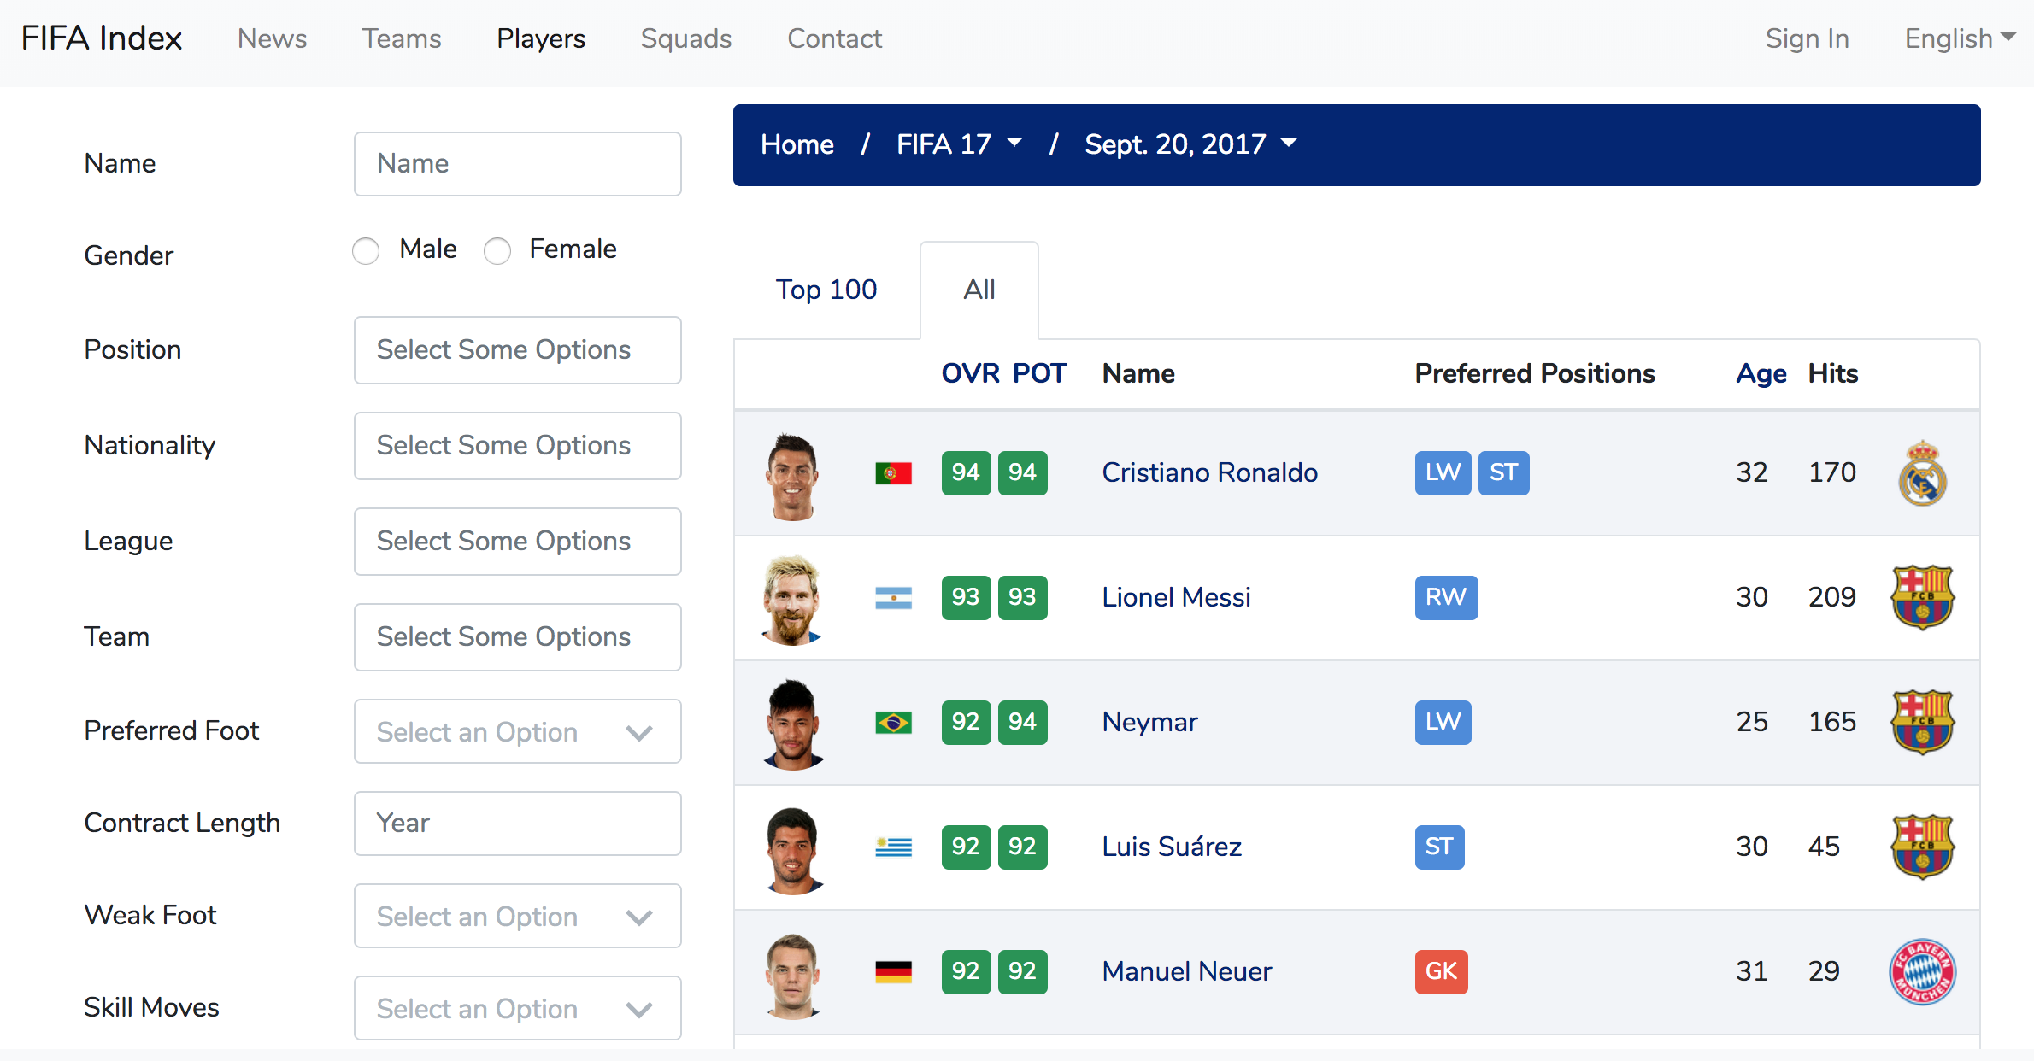
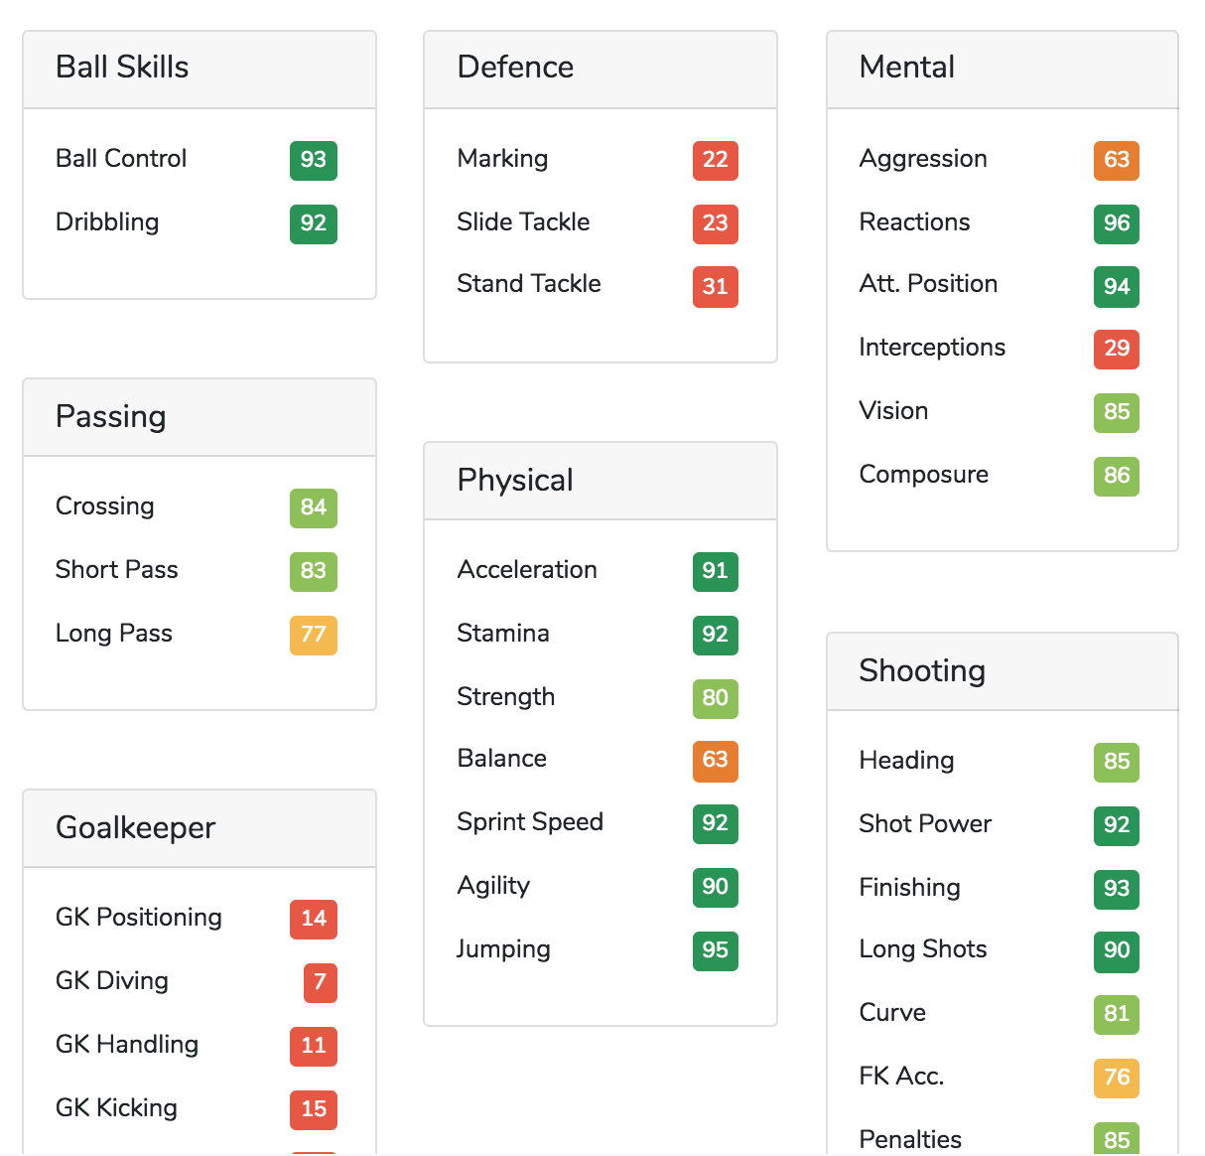

Slide 5
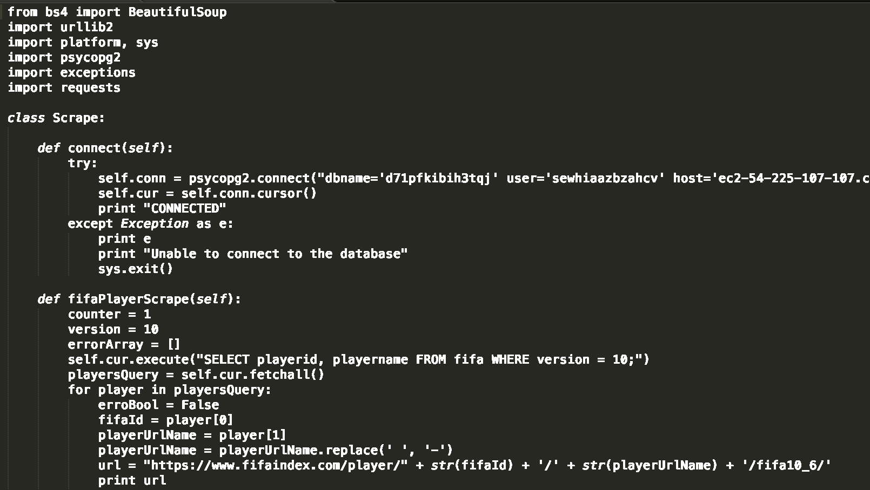
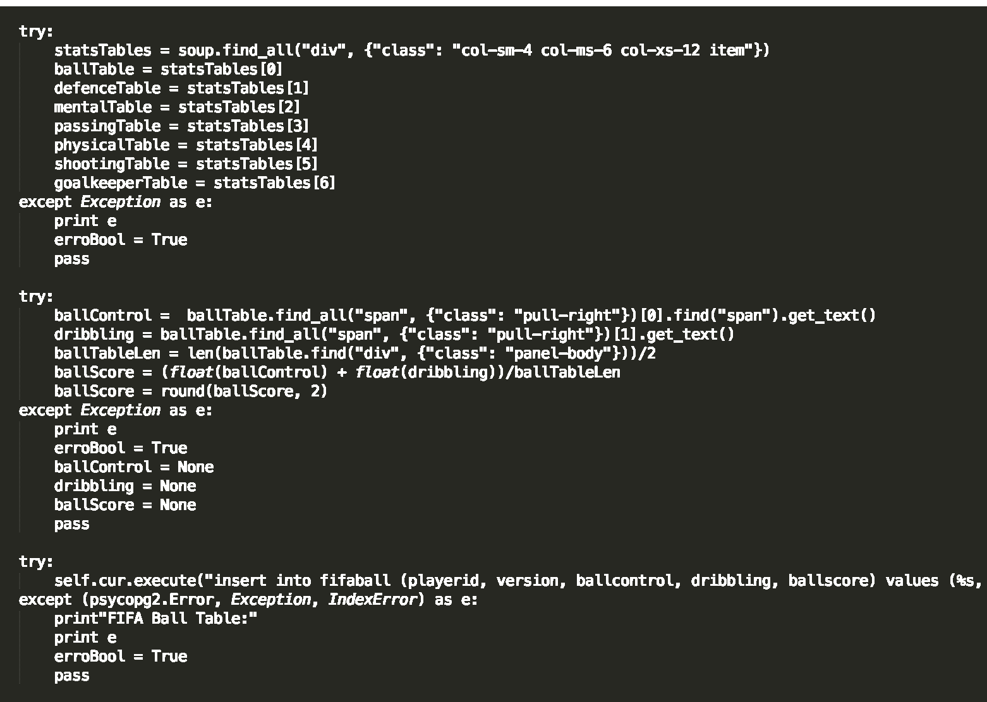

Slide 6
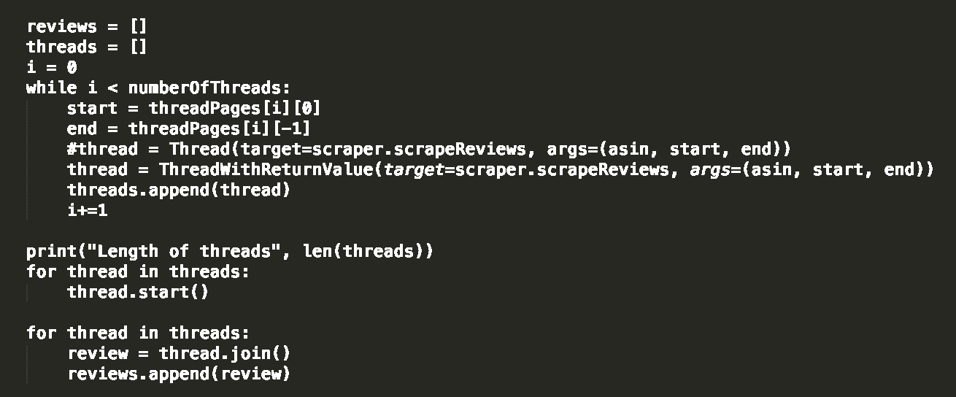
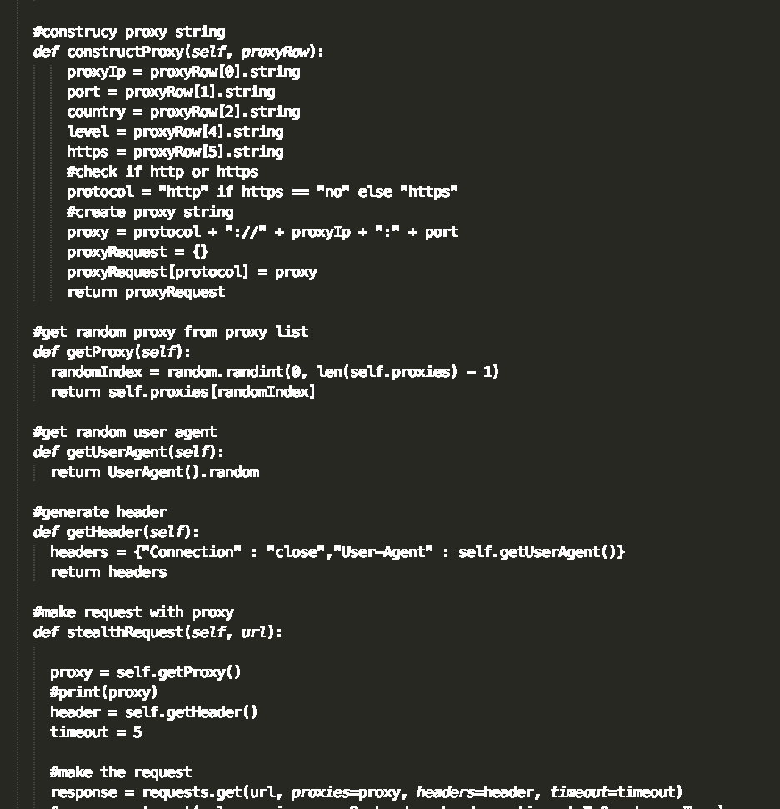

Slide 7
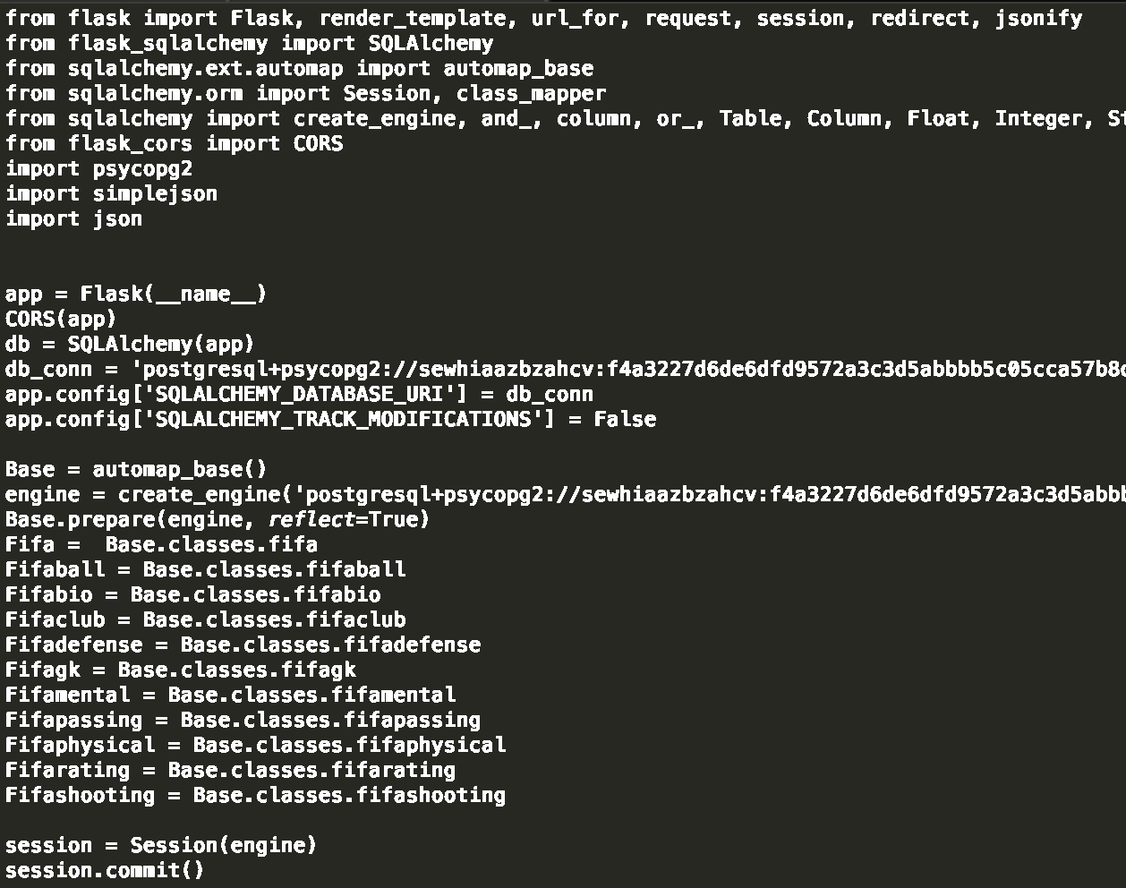
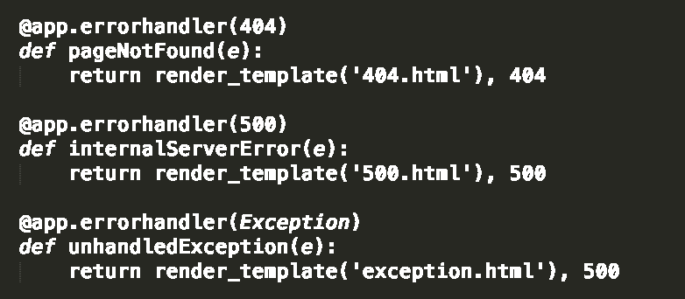

Slide 8
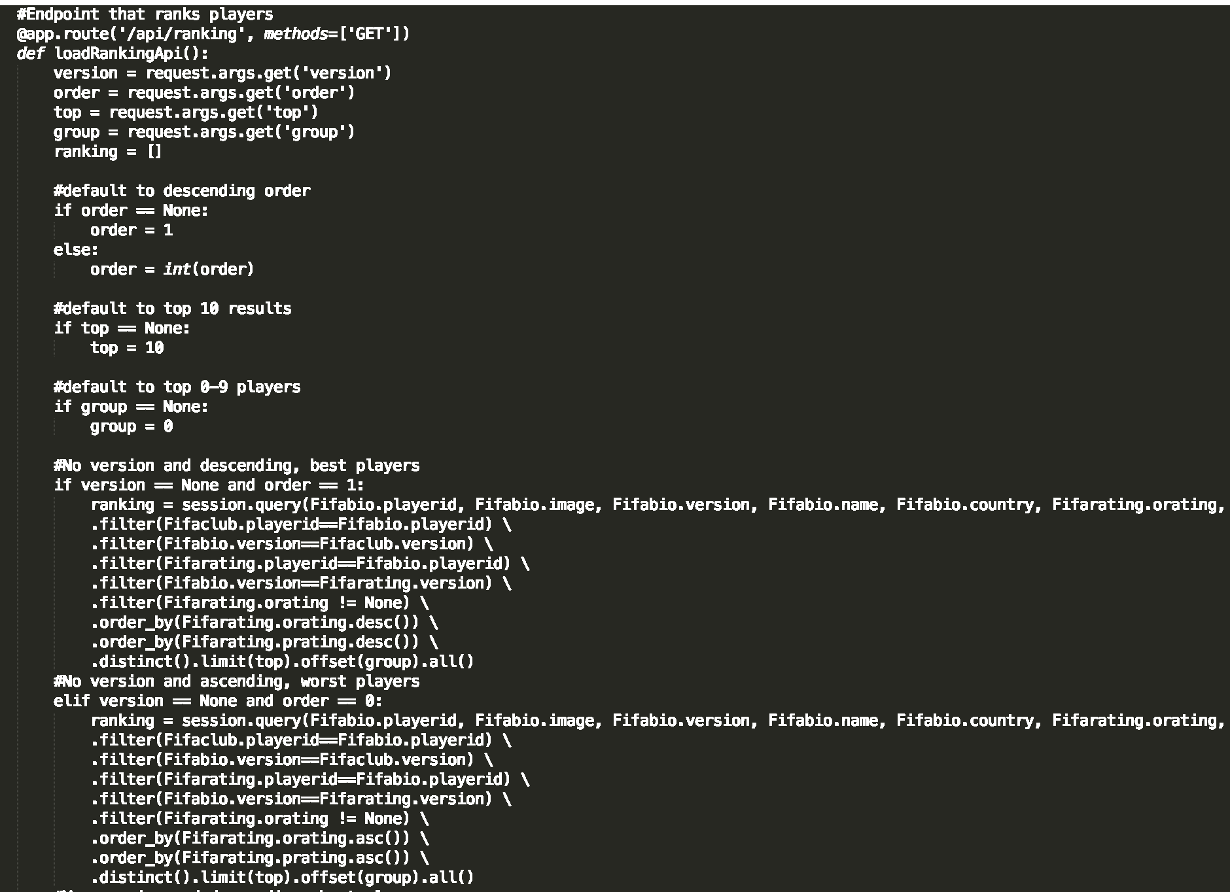
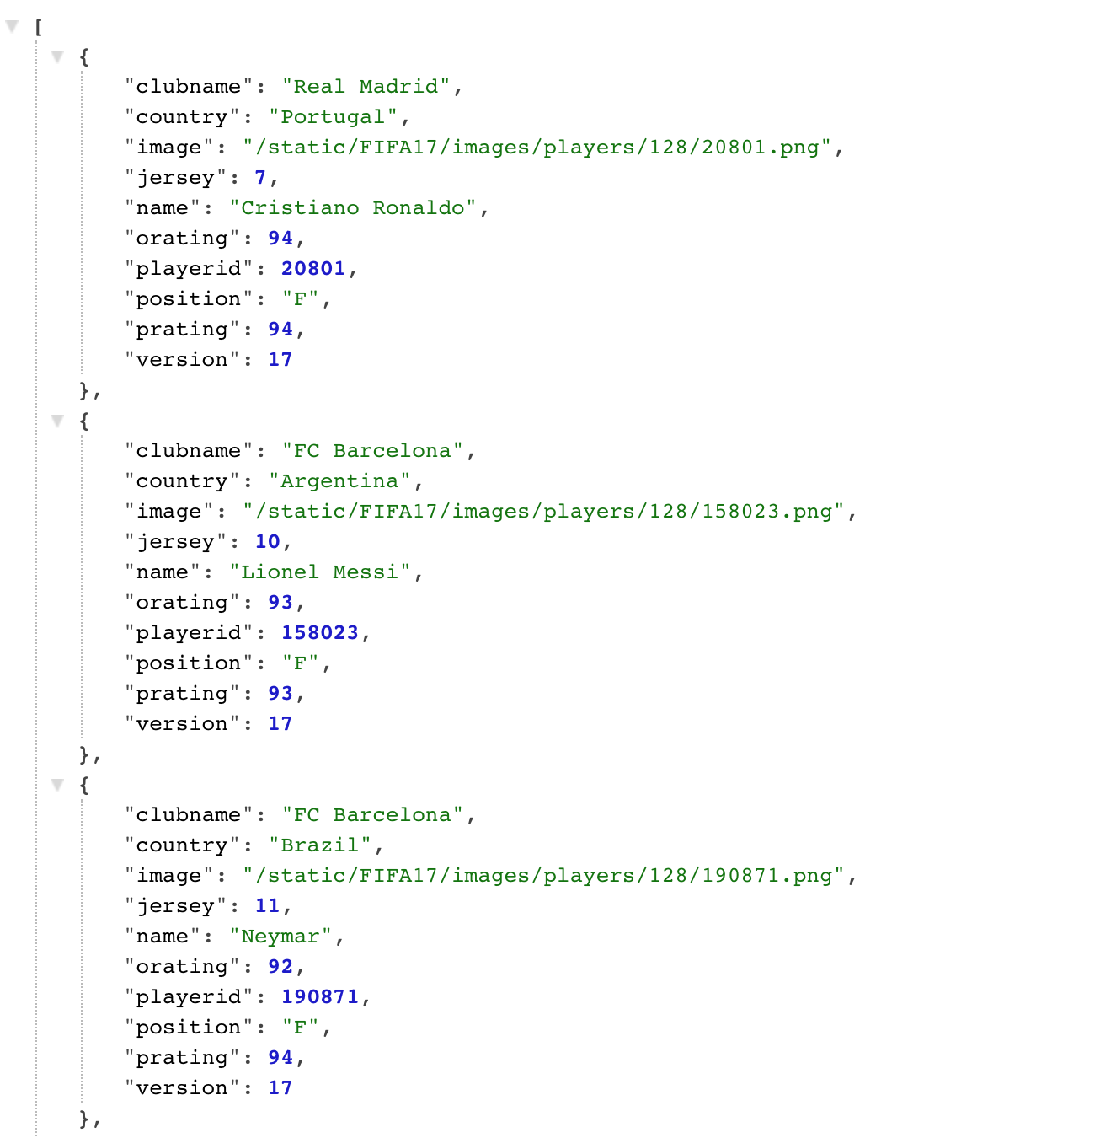

Slide 9
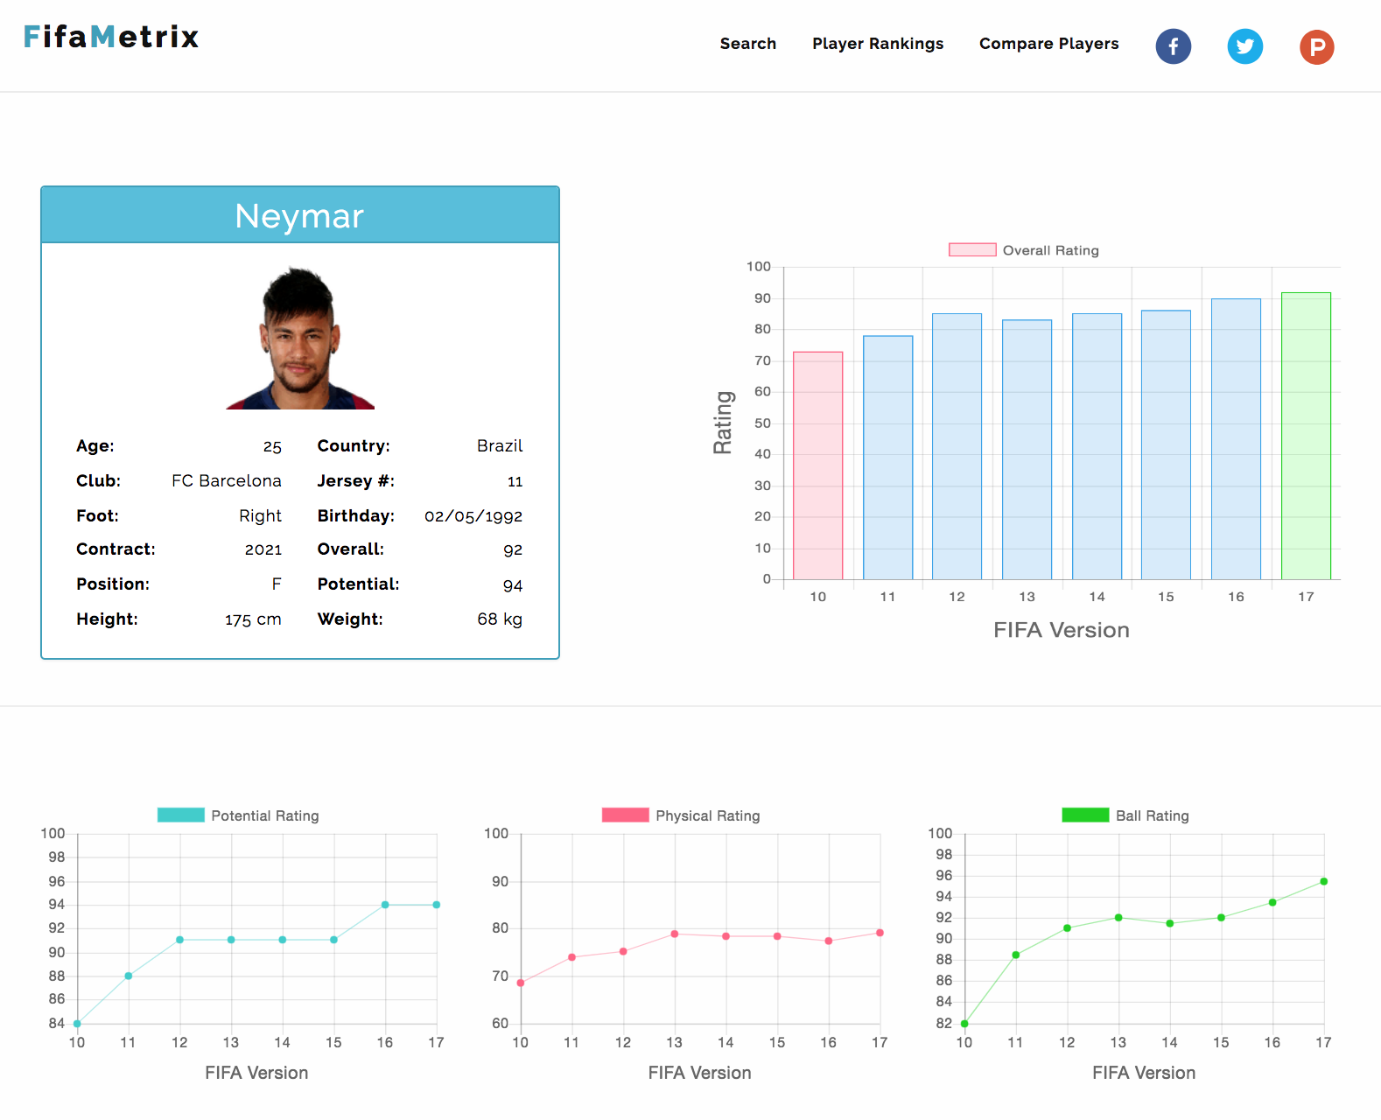

Slide 10
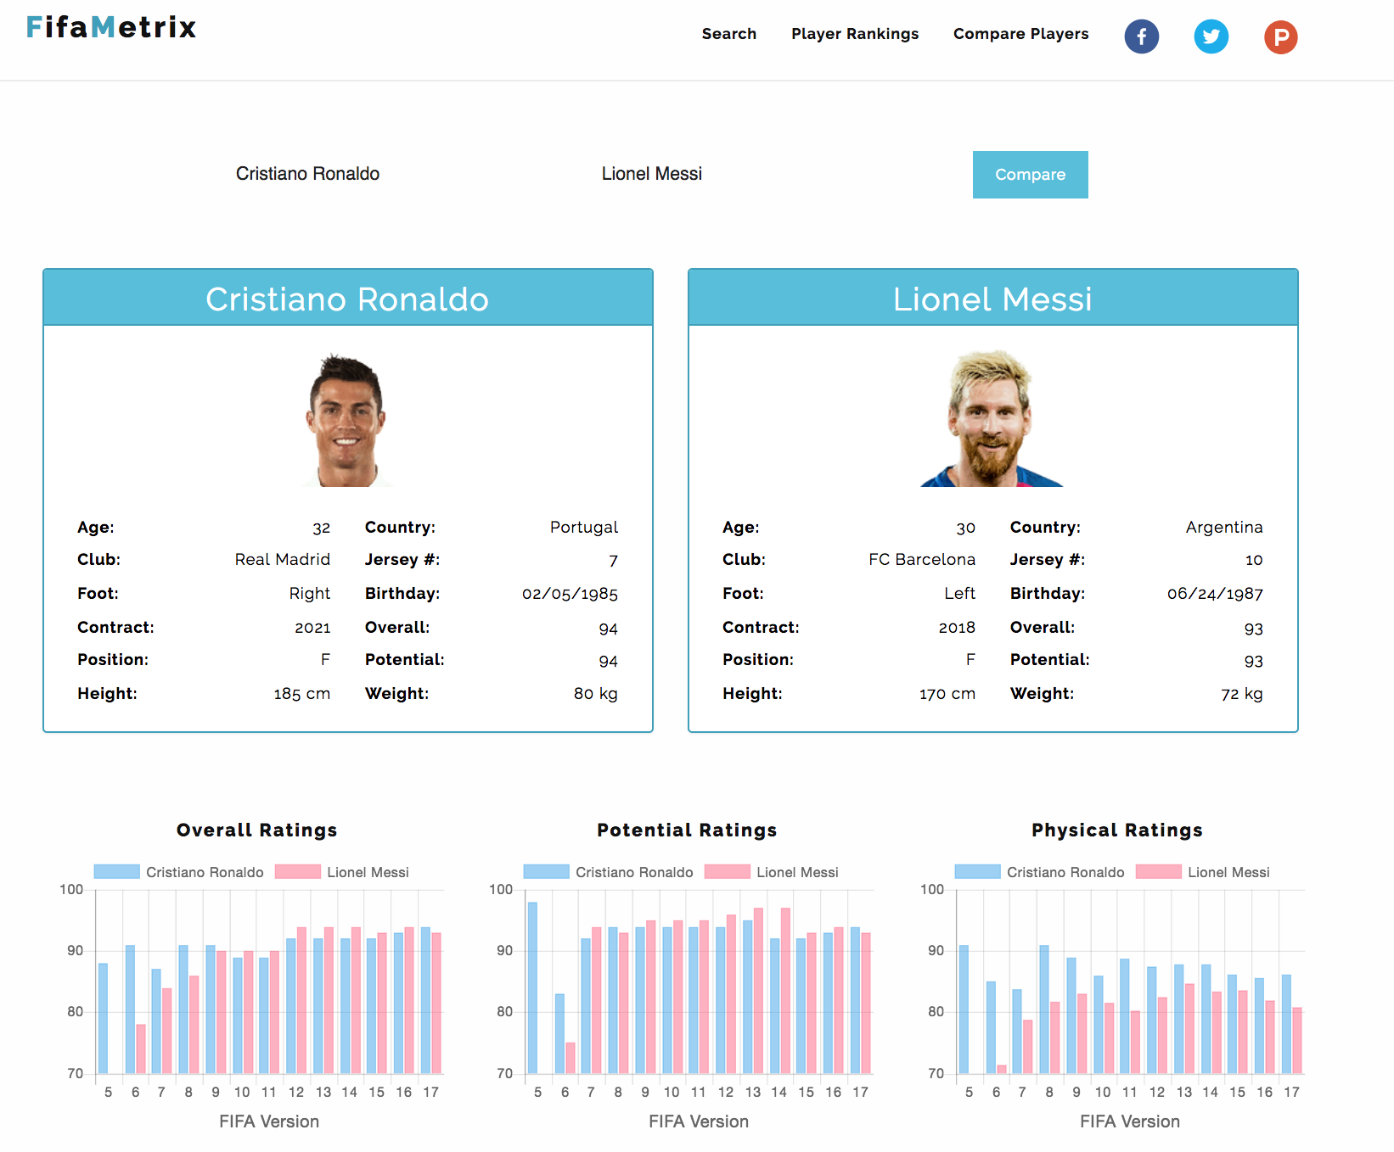

Slide 11
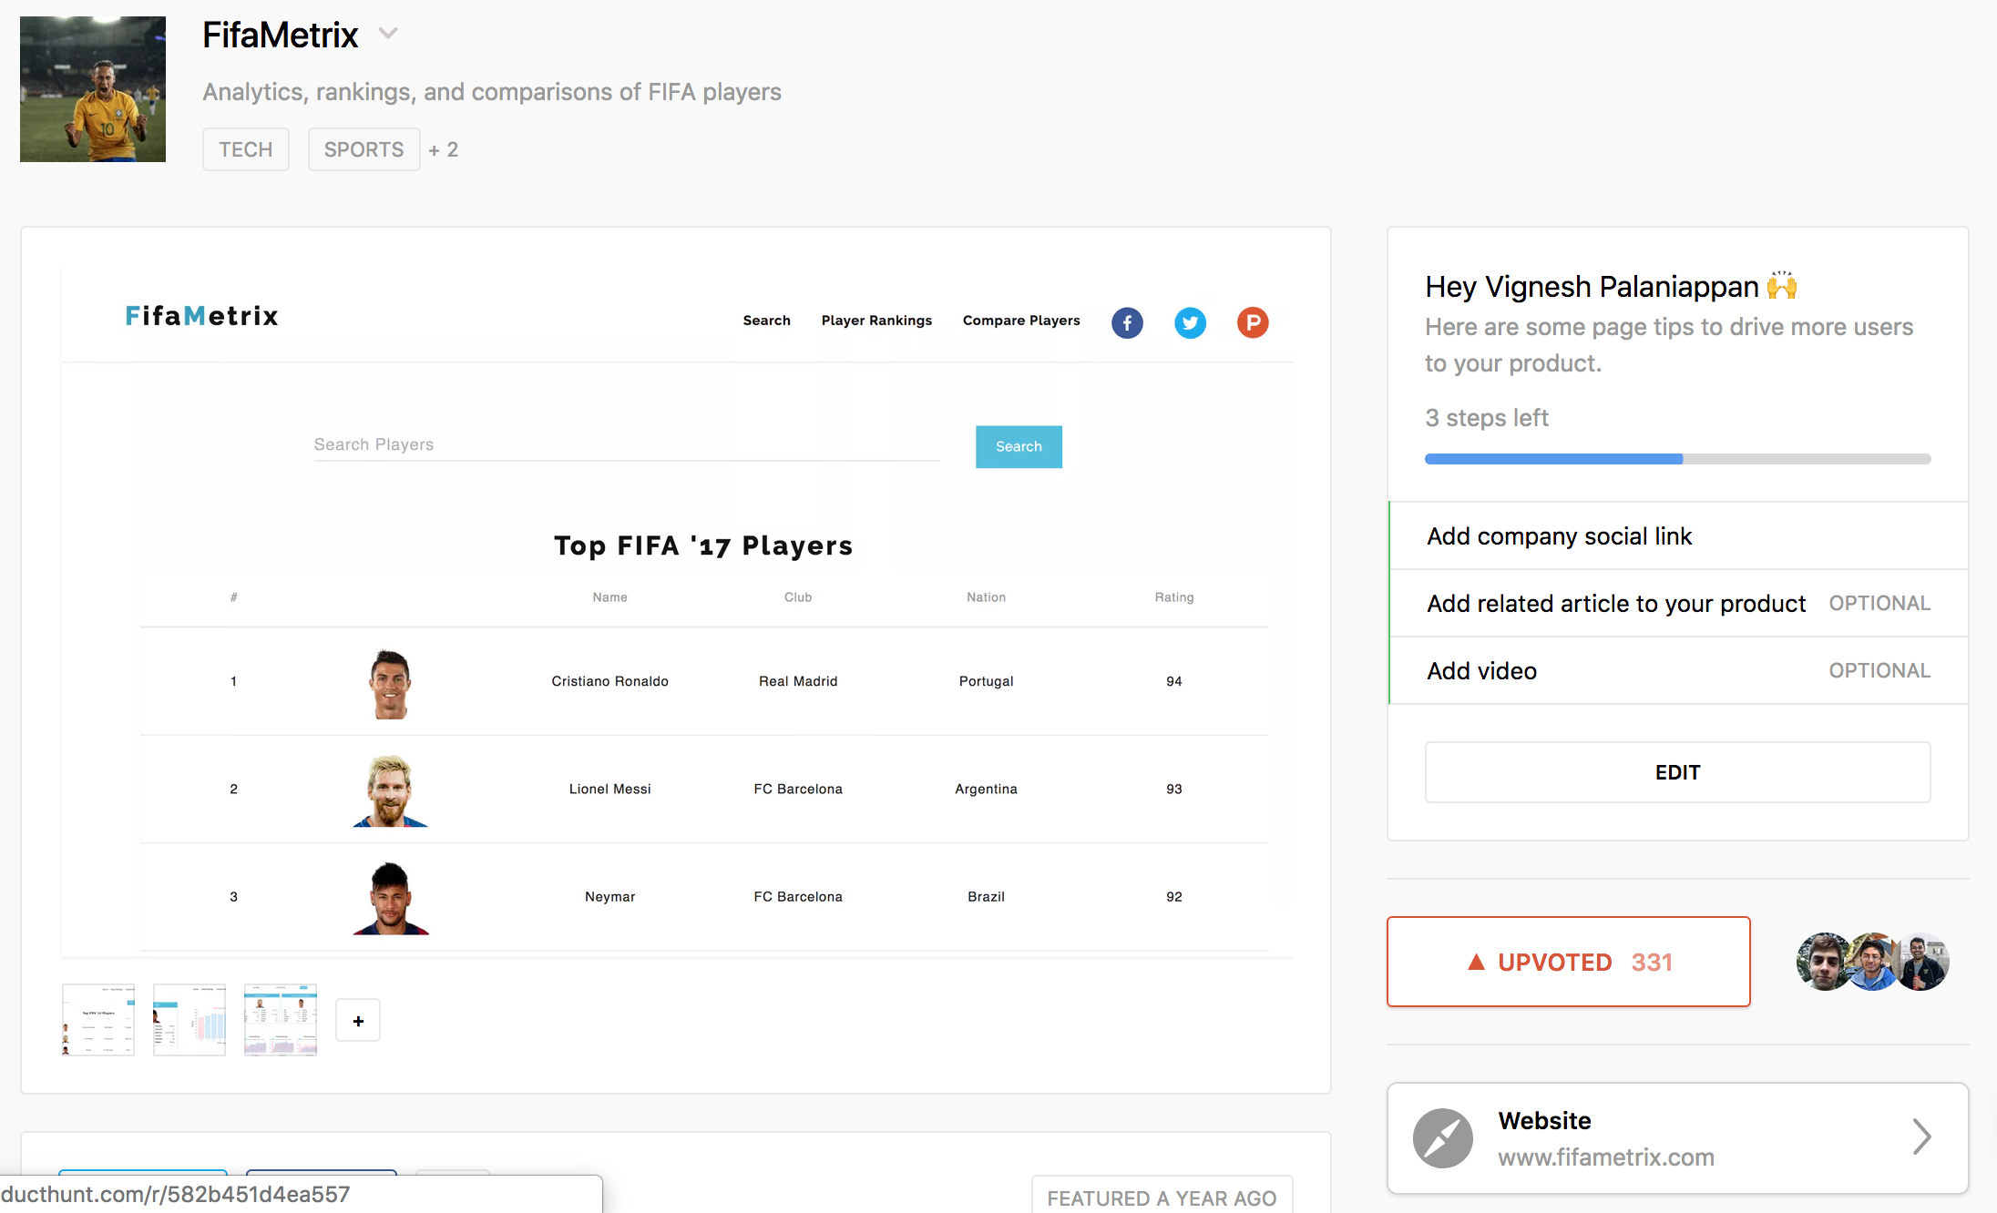

Slide 12

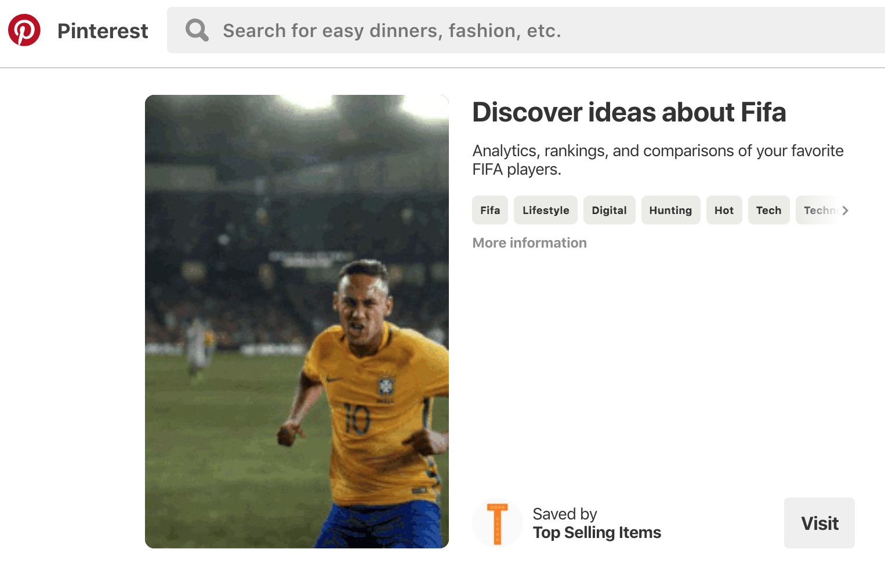
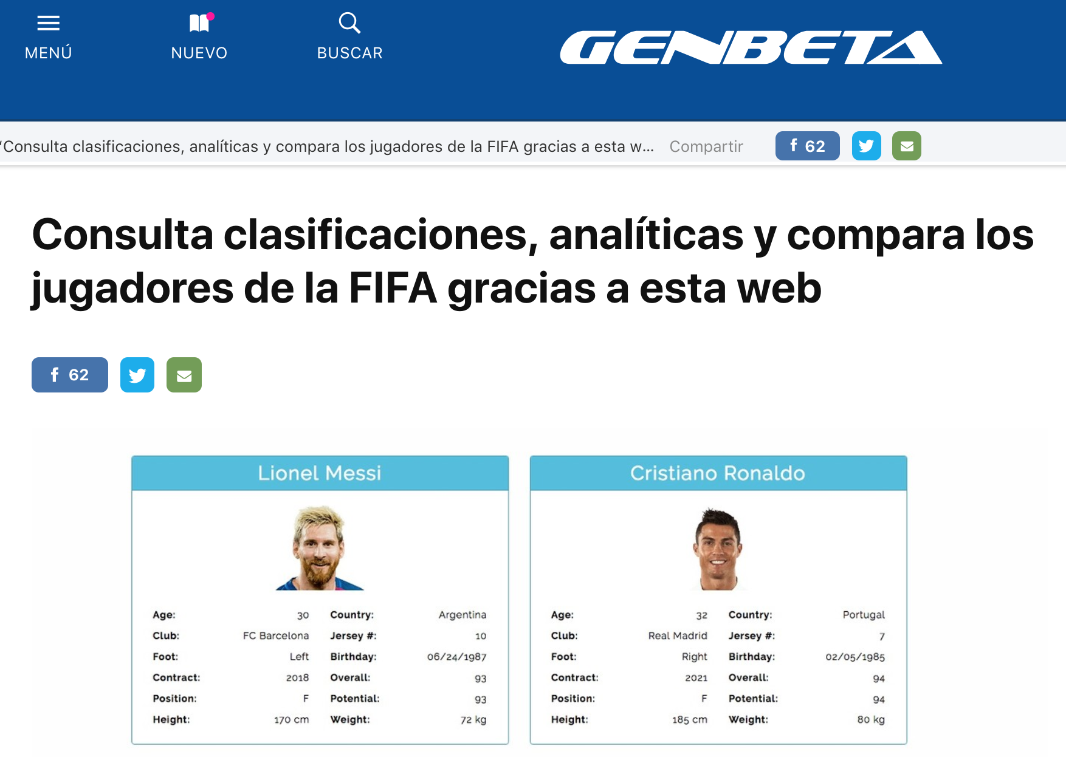


Slide 13
